Slide 1
Functions in Python
By Dr Shantanu Pathak

Slide 2
Part 2

Slide 3
Variable Scope
How python program maintains values of variables ?
globals() : for global variables
locals() : for variables inside function
How value of a variable is searched ?
local scope, non local scope, global scope
What happens if two functions use same variable name ?
Ex. add() and subtract() both using result variable
By Using scope of the variable

Slide 4
Variable Scope
It is also known as lifetime of a variable
Local Scope :: Only inside the function
Cannot be accessed after the function
Can be changed only inside the function
Global Scope :: Can be accessed anywhere in current script
Can be changed anywhere in the script
Example add function with local and global variable

Slide 5
Variable Scope
Why NOT to use global variables?
They can be modified anywhere, so un-intentionally may be modified somewhere
Code using global variable may not work in other script (not portable code)
How to access(read) value and modify(write) value of global variable inside function?
Only access value is directly allowed
To modify ( write) a global variable needs use of “global” keyword
Python makes use of this syntax to remind programmer that a global variable is being modified (which is not very good idea)

Slide 6
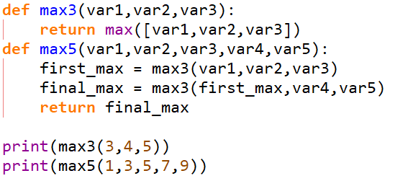
Variable Scope
How to use variables of one function in another?
Pass variables as arguments
Use / Store the return values from a function
Ex. Write function to find max of three numbers
Write function to find max of five numbers

Slide 7
Function within function
python allows function within a function
variables of outside functions are directly accessible in inner function
a function can return another function
This trick of function within function is used in some GUI tools like Tkinter

Slide 8
Lambda function
it is a function for single line operation
it can take any number of parameters
it doesn't have a name (anonymous)
it creates a function object
Any normal function can also be used wherever lambda is used.
NOTE:: This is not like a inline function. It is also as slow as normal function. Lambda function is not faster than normal function

Slide 9
Lambda function
Examples:
Sort list using lambda
Sort characters based on their occurrence in other string
Sort dictionary by value
How to have Multiple operations in single line?
How to Assign name to a lambda function?

Slide 10
Higher Order Functions
Function which takes function as a parameter are called as higher order functions
Example sorted function
it takes key function as a parameter
Map Function
applies given function to all elements from iterable (list, string, etc)

Slide 11
Map Function
applies a function to an iteratable object
object containing more than one element
map(fun , iteratable)
Example
Numbers=[10,20,30]
result = map(lambda x: x**0.5, numbers)
r1 = map(math.sqrt,numbers)
Special case
Mapping function with two arguments
result = map(lambda x, y: x + y, numbers1, numbers2)

Slide 12
Generator Function
A function which behaves like an iterator
Iterator means like list or array or set, something on which you can run a loop
Generator functions have special approach of not storing all elements in the memory
Very memory efficient
Uses yield keyword and return is optional
Tuple comprehension gives a generator function

Slide 13
Yield keyword
Syntax : yield <value> or yield <var name>
Tells function to send current value of the variable to the calling function
Yield suspends current function execution
Yield doesn’t stop the function execution!
Only sends one value at a time
After yield state of the function is remembered
So, when generator function is used with next() function it keeps on giving next value

Slide 14
Example of generator function
def infinite_seq():
num = 0
while True:
yield num
num +=1
iseq= infinite_seq() # create iterator
next(iseq) # access the values one by one
This will every time return a next number infinitely!
But its not going to block your code like a infinite loop!

Slide 15
Application of Generator Functions
Process a large file line by line
def csv_reader(filename):
with open(filename) as f:
for row in f:
yield row
My_csv_gen = csv_reader(filename)
Now use this ‘My_csv_gen’ with a for loop to extract data line by line
Working of csv_reader

